Slide 1





Extending Computer Vision to Hidden Objects
A Tutorial on Millimeter-Wave Imaging and Reconstruction of Occluded Scenes
Jiachen Lu
Jiachen Lu

Slide 2
How many of you have heard of wireless signals (WiFi, Bluetooth, mmWave)?
How many of you have heard of mmWave (5G, 6G, Next-Gen WiFi)?
How many of you have prior knowledge on mmWave sensing (Imaging, FMCW, AoA)?
How many of you have prior research experience in mmWave sensing?
No prior mmWave experience necessary!
Notes:
After 2nd: in what context have you heard it?

Slide 3
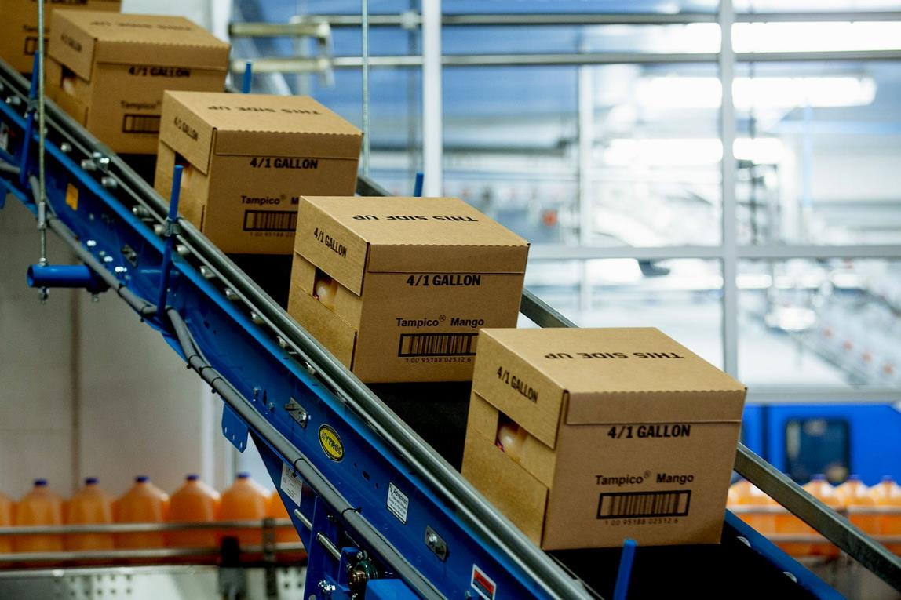
There have been incredible advances in computer vision

Slide 4

There have been incredible advances in computer vision

Slide 5
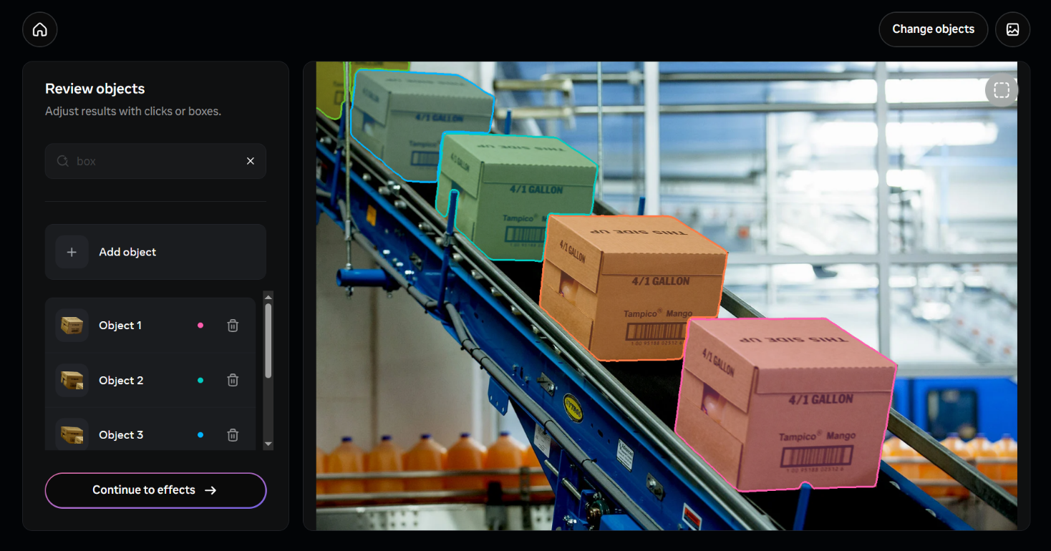
There have been incredible advances in computer vision

Slide 6
There have been incredible advances in computer vision
What is inside the boxes?
What if we could build imaging & perception systems
which can see hidden objects?

Slide 7
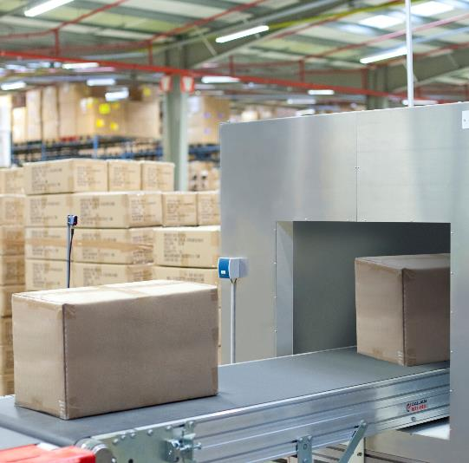
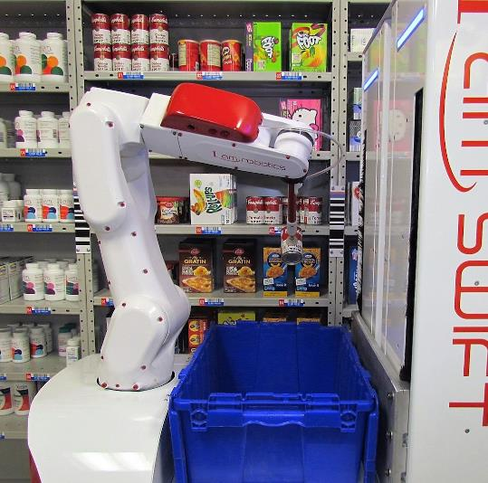
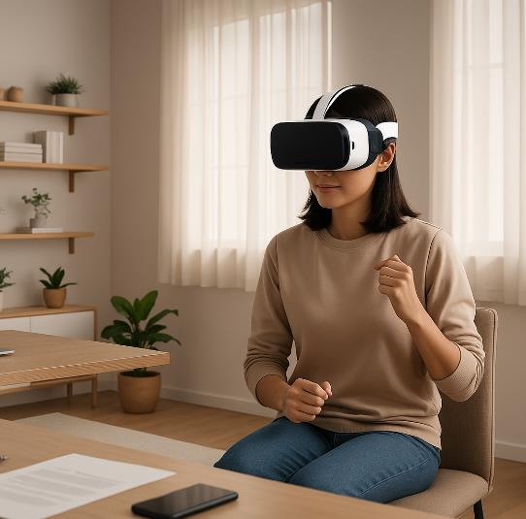


High-Accuracy Non-Line-of-Sight 3D Reconstruction has Many Applications
Shipping & Logistics
Robotics
Augmented Reality
camera view static (gone), robot scanning (v fast or only partial),
- camera view gets bigger, open box
- blur to spoon
gets smaller
Add baseline
Add ours
Spin all 3

Slide 8
Wireless signals can travel through everyday occlusions

Slide 9
Wireless signals can travel through everyday occlusions
Millimeter-Wave (mmWave)
5G, 6G, Next-Gen WiFi

Slide 10
Wireless signals can travel through everyday occlusions
Millimeter-Wave (mmWave)
5G, 6G, Next-Gen WiFi
Cardboard
Plastic
Fabric
Fog
Smoke

Slide 11
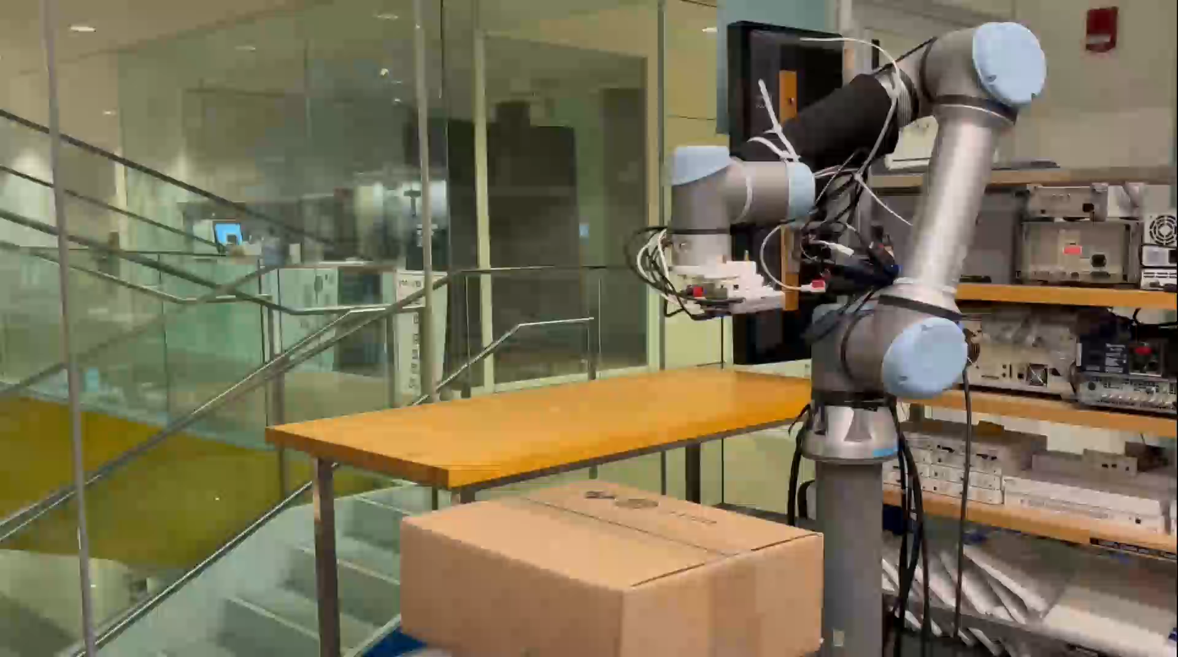
Wireless signals can travel through everyday occlusions
We can use them to image, reconstruct, & perceive the hidden environment

Slide 12
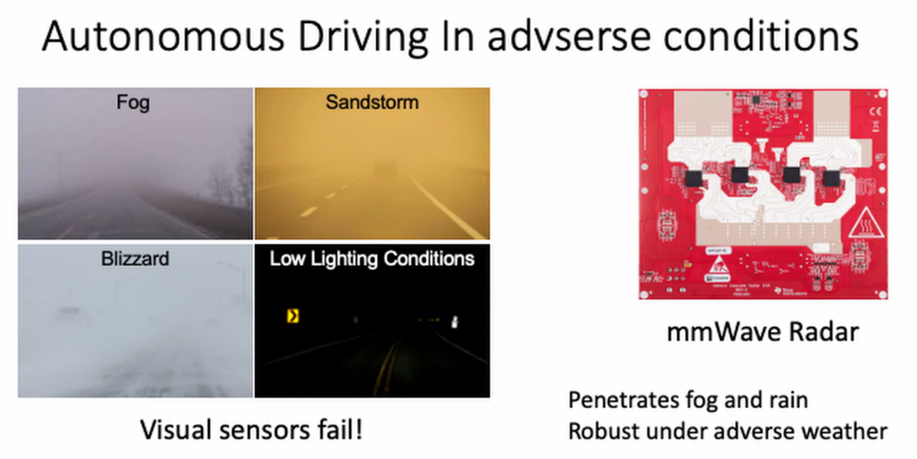
Wireless signals can travel through everyday occlusions
We can use them to image, reconstruct, & perceive the hidden environment

Slide 13

Wireless signals can travel through everyday occlusions
We can use them to image, reconstruct, & perceive the hidden environment

Slide 14
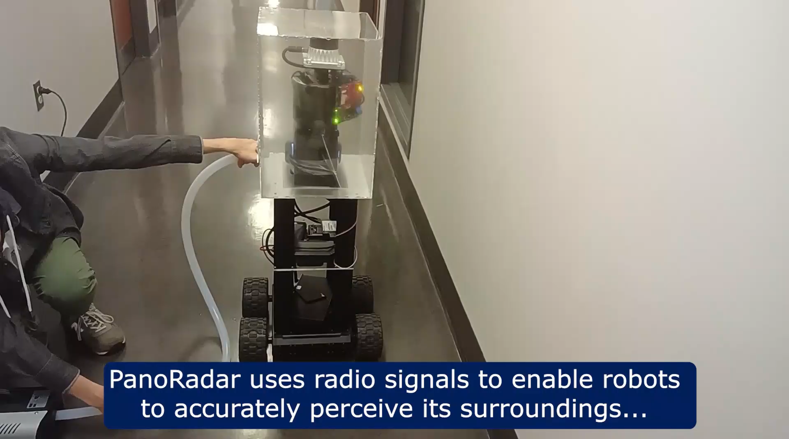
Wireless signals can travel through everyday occlusions
We can use them to image, reconstruct, & perceive the hidden environment

Slide 15
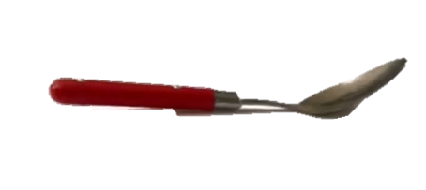
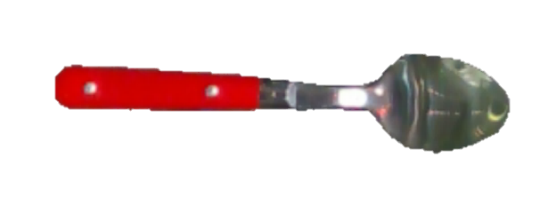
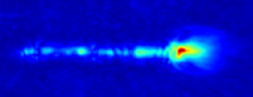
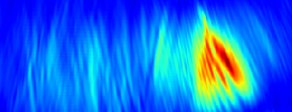
Is mmWave imaging & reconstruction a solved problem?
Top View
Side View

Slide 16
Is mmWave imaging & reconstruction a solved problem?
Top View
Side View
Missing Parts
High Noise
Large Power Spread

Slide 17
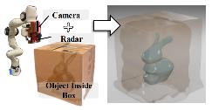
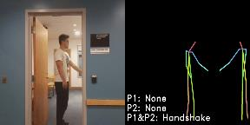
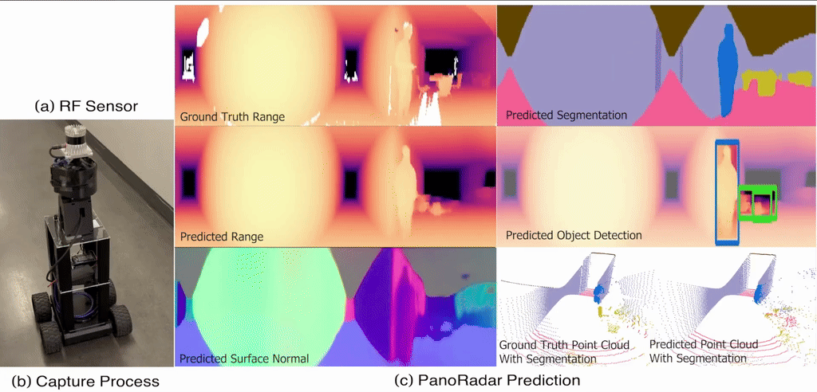
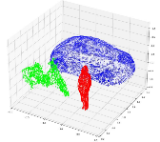
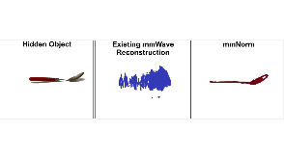
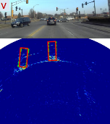
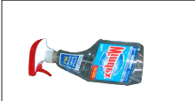
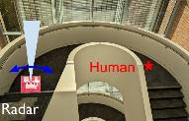
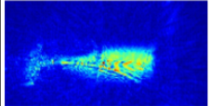
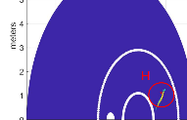
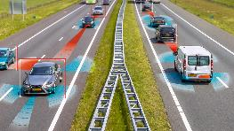
What are most common mmWave imaging research domains?
Complexity
3D
Reconstruction
3D Skeletons & Meshes
+ Gesture Recognition
+ Vital Monitoring
+ Segmentation
+ Material property estimation
+SLAM
High-Fidelity Reconstruction
Presence Detection or Coarse Imaging
Object Bounding Boxes
Object Imaging
+ Classification
+Segmentation
Human Detection
Obstacle Detection: Widely Deployed
Scale
Object Level
Human Level
Scene Level

Slide 18
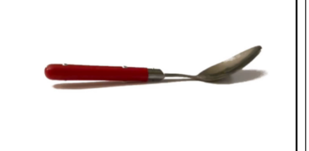
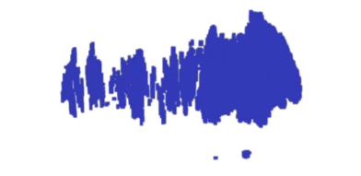
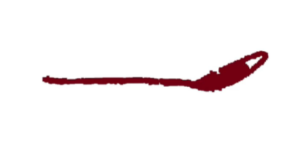
Extending Computer Vision to Hidden Objects
A Tutorial on Millimeter-Wave Imaging and Reconstruction of Occluded Scenes
mmWave 101: Basics of mmWave Imaging, Limitations
State-of-the-art Reconstruction Methods
mmWave Neural Radiance Fields
Coffee Break
Vision-quality mmWave Scene Understanding
Open Problems; Tour of Existing Datasets & Tools
Hands-On Tutorial: mmWave Imaging & Reconstruction

Slide 19
Extending Computer Vision to Hidden Objects
A Tutorial on Millimeter-Wave Imaging and Reconstruction of Occluded Scenes
mmWave 101: Basics of mmWave Imaging, Limitations
State-of-the-art Reconstruction Methods
mmWave Neural Radiance Fields
Coffee Break
Vision-quality mmWave Scene Understanding
Open Problems; Tour of Existing Datasets & Tools
Hands-On Tutorial: mmWave Imaging & Reconstruction

Slide 20
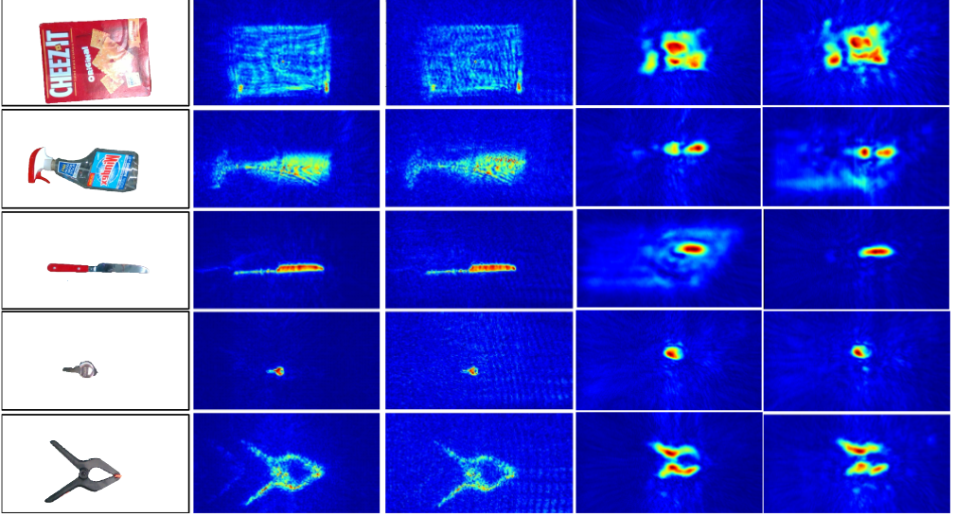
mmWave 101:
The basics of mmWave imaging

Slide 21
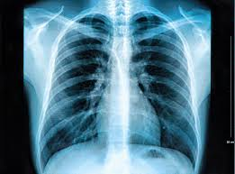
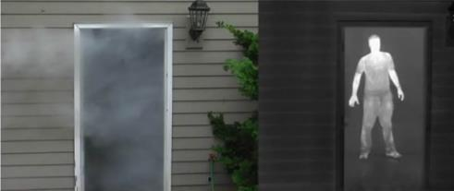
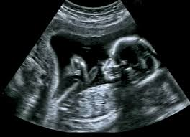
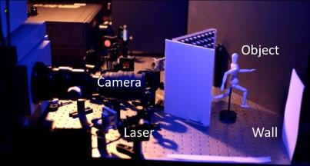
How does mmWave compare to other through-occlusion modalities?
XRay
Thermal
Unsafe for
extended exposure
Requires heat
Cannot see through walls
Ultrasound
Reflected Lasers
mmWave is safe, operates through occlusions,
and can image everyday objects
Requires gel to
minimize mismatch
Cannot travel
through occlusions

Slide 22
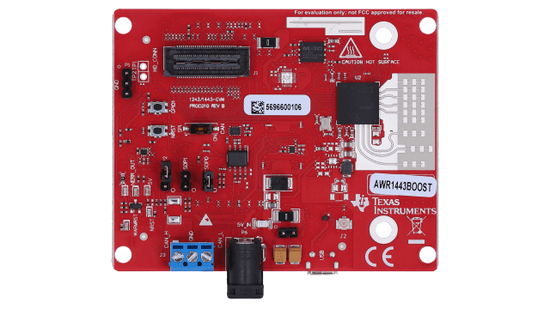
What is a mmWave sensor?
“Radar”
Antenna
Array

Slide 23
What is a mmWave sensor?
“Radar”
Antenna
Array
A mmWave radar transmits and receives signals
It does not directly capture an image

Slide 24
How do we measure a mmWave Image?
Angle
(ϴ)
Single Point Reflector
Range (r)
Image
Each pixel is an approximation of power reflected from that point
Estimate the power reflected from this point (range, angle) in space

Slide 25
How do we measure a mmWave Image?
Angle
(ϴ)
Single Point Reflector
Range (r)
Image
Estimate the power reflected from this point (range, angle) in space

Slide 26
How do we measure a mmWave Image?
Angle
(ϴ)
Range (r)
Estimate the power reflected from this point (range, angle) in space

Slide 27
How do we measure a mmWave Image?
Estimate the power reflected from this point (range, angle) in space

Slide 28
How do we measure a mmWave Image?
Estimate the power reflected from this point (range, angle) in space
How do we estimate range with mmWave signals?
How do we estimate angle with mmWave signals?

Slide 29
How do we measure a mmWave Image?
Estimate the power reflected from this point (range, angle) in space
How do we estimate range with mmWave signals?
How do we estimate angle with mmWave signals?

Slide 30


How do we estimate range with mmWave signals?
Measure time it takes signal to travel to object and back
“Time of Flight”
Notes:
This is equalivent to trying to find out how far away a light source is based on delay between turning it on and seeing it in your video camera

Slide 31
How do we estimate range with mmWave signals?
Measure time it takes signal to travel to object and back
“Time of Flight”
Notes:
This is equalivent to trying to find out how far away a light source is based on delay between turning it on and seeing it in your video camera

Slide 32
How do we estimate range with mmWave signals?
Measure time it takes signal to travel to object and back
“Time of Flight”
Notes:
This is equalivent to trying to find out how far away a light source is based on delay between turning it on and seeing it in your video camera

Slide 33
How do we estimate range with mmWave signals?
Measure time it takes signal to travel to object and back
“Time of Flight”
Measuring time of flight directly is very difficult
> $10k
Range = Speed of Light x Time of Flight
r = c x τ
Notes:
This is equalivent to trying to find out how far away a light source is based on delay between turning it on and seeing it in your video camera

Slide 34
How do we estimate range with mmWave signals?
Frequency Modulated Continuous Wave (FMCW)
Create a relationship between time of flight and frequency
Transmit
Amplitude
Frequency
Transmit
Time
Time
Notes:
This is equalivent to trying to find out how far away a light source is based on delay between turning it on and seeing it in your video camera

Slide 35
How do we estimate range with mmWave signals?
Frequency Modulated Continuous Wave (FMCW)
Create a relationship between time of flight and frequency
Transmit
Amplitude
Frequency
Transmit
Receive
Time
Time
Notes:
This is equalivent to trying to find out how far away a light source is based on delay between turning it on and seeing it in your video camera

Slide 36
How do we estimate range with mmWave signals?
Frequency Modulated Continuous Wave (FMCW)
Create a relationship between time of flight and frequency
Transmit
Receive
Amplitude
Frequency
Transmit
Receive
Time
Time
Notes:
This is equalivent to trying to find out how far away a light source is based on delay between turning it on and seeing it in your video camera

Slide 37
How do we estimate range with mmWave signals?
Frequency Modulated Continuous Wave (FMCW)
Create a relationship between time of flight and frequency
Transmit
Receive
Frequency
Slope (k)
Δf
τ
Time
Slope = Difference in Frequency / Time of Flight
k = Δf / τ
Notes:
This is equalivent to trying to find out how far away a light source is based on delay between turning it on and seeing it in your video camera

Slide 38
How do we estimate range with mmWave signals?
Frequency Modulated Continuous Wave (FMCW)
Create a relationship between time of flight and frequency
Difference in Frequency
Signal with frequency Δf
Transmit
Frequency
Mixer
Slope (k)
Amplitude
Δf
Receive
τ
Time
Time
Analog Circuit Component
Multiplies Two Signals
Slope = Difference in Frequency / Time of Flight
k = Δf / τ
Notes:
This is equalivent to trying to find out how far away a light source is based on delay between turning it on and seeing it in your video camera

Slide 39
How do we estimate range with mmWave signals?
Frequency Modulated Continuous Wave (FMCW)
Create a relationship between time of flight and frequency
Difference in Frequency
Signal with frequency Δf
Transmit
Frequency
Mixer
Slope (k)
Δf
Amplitude
Receive
τ
Time
Time
Analog Circuit Component
Multiplies Two Signals
Slope = Difference in Frequency / Time of Flight
k = Δf / τ
Notes:
This is equalivent to trying to find out how far away a light source is based on delay between turning it on and seeing it in your video camera

Slide 40
How do we estimate range with mmWave signals?
Frequency Modulated Continuous Wave (FMCW)
Create a relationship between time of flight and frequency
Difference in Frequency
Signal with frequency Δf
Transmit
Frequency
Mixer
Slope (k)
Δf
Amplitude
Receive
τ
Time
Time
Analog Circuit Component
Multiplies Two Signals
Slope = Difference in Frequency / Time of Flight
k = Δf / τ
We need to find Δf to find range

Slide 41





How do we estimate range with mmWave signals?
Frequency Modulated Continuous Wave (FMCW)
Create a relationship between time of flight and frequency
Amplitude
Amplitude
$$P\left(r′\right)$$
Fourier Transform
Time
$$Δf$$
$$k τ$$
Frequency
s(t) = cos(2 π Δf t + 2 π f₀ τ)
$$s\left(t\right)=cos⁡(2 \text{π} Δf t+2 \text{π} f_{0 }τ)$$
s(t) = cos(2 π k τ t + 2 π f₀ τ)
$$s\left(t\right)=cos⁡(2 \text{π} k τ t+2 \text{π} f_{0 }τ)$$
$$P\left(r′\right)=\sum_{t=1}^{T}{s\left(t\right)e^{−j 2\text{π} ktr^{′}/c}}$$
s(t) = cos(2 π k r t / c + 2 π f_{0 r} / c)
$$s\left(t\right)= e^{j (2 \text{π} k τ t+2 \text{π} f_{0} τ)}$$
s(t) = e j 2 π k t r /c + j 2 π f0 r / c
$$s\left(t\right)= e^{j (2 \text{π} k \frac{r}{c} t+ 2 \text{π} f_{0 }\frac{r}{c})}$$
We need to find Δf to find range

Slide 42

How do we estimate range with mmWave signals?
Amplitude
Frequency
Transmit
Amplitude
Transmit
Δf
Mixer
Slope (k)
Amplitude
Receive
τ
Receive
Fourier
Transform
Frequency
Time
Time
Time
Δf
k τ
k r / c
$$P\left(r′\right)=\sum_{t=1}^{T}{s\left(t\right)e^{−j 2\text{π} ktr^{′}/c}}$$

Slide 43

How do we measure a mmWave Image?
Estimate the power reflected from this point (range, angle) in space
How do we estimate range with mmWave signals?
$$P\left(r′\right)=\sum_{t=1}^{T}{s\left(t\right)e^{−j 2\text{π} ktr^{′}/c}}$$
Amplitude
Frequency
Transmit
Mixer
Amplitude
Transmit
Slope (k)
Δf
Amplitude
Receive
τ
Receive
Fourier
Transform
Time
Time
Time
Δf
k τ
k r / c
Frequency
How do we estimate angle with mmWave signals?

Slide 45
How do we estimate angle with mmWave signals?

Slide 46
How do we estimate angle with mmWave signals?
Compare difference between signal at two locations

Slide 47
How do we estimate angle with mmWave signals?
Compare difference between signal at two locations

Slide 48
How do we estimate angle with mmWave signals?
Compare difference between signal at two locations

Slide 49
How do we estimate angle with mmWave signals?
Compare difference between signal at two locations

Slide 50
How do we estimate angle with mmWave signals?
Far Field Assumption
Reflector is far away that the lines become parallel

Slide 51
How do we estimate angle with mmWave signals?
Far Field Assumption
Reflector is far away that the lines become parallel

Slide 52
How do we estimate angle with mmWave signals?

Slide 53
How do we estimate angle with mmWave signals?

Slide 54



How do we estimate angle with mmWave signals?
$$ℓ$$
Angle
(ϴ)
Extra
Distance
Extra
Distance
$$∆r=ℓcos⁡(θ)$$
$$θ=acos⁡\left(\frac{∆r}{ℓ}\right)$$
Signal travels equal distances
Signal travels further to right antenna
Signal travels further to left antenna

Slide 55








How do we estimate angle with mmWave signals?
$$ℓ$$
$$s\left(t\right)= e^{j2\text{π} k\frac{r}{c}t+j2\text{π} f_{0 }\frac{r}{c}}$$
Angle
(ϴ)
$$∠ s_{1}=2\text{π}f_{0 }\frac{r_{1}}{c}$$
Extra
Distance
$$∠ s_{2}=2\text{π}f_{0 }\frac{r_{2}}{c}$$
$$∆r=ℓcos⁡(θ)$$
$$∠ s_{1}−∠ s_{2}=2\text{π}f_{0 }\frac{r_{1} − r_{2}}{c}$$
$$θ=acos⁡\left(\frac{∆r}{ℓ}\right)$$
$$∠ s_{1}−∠ s_{2}=2\text{π}f_{0 }\frac{∆r}{c}$$
$$∆r=\frac{\left(∠ s_{1}−∠ s_{2}\right) c}{2\text{π}f_{0 }}$$
$$θ=acos⁡\left(\frac{\left(∠ s_{1}−∠ s_{2}\right) c}{2\text{π}f_{0 }ℓ}\right)$$

Slide 56






How do we estimate angle with mmWave signals?
$$ℓ$$
Angle
(ϴ)
Fourier Transform
$$∆r=2ℓcos⁡(θ)$$
Amplitude
$$P\left(θ^{′}\right)$$
$$∆r=3ℓcos⁡(θ)$$
$$θ$$
Angle
$$θ^{′}$$
$$P\left(θ^{′}\right)=\sum_{a=1}^{A}{s_{a}e^{−j2πf_{0}aℓcos⁡(θ^{′})/c}}$$

Slide 57





How do we measure a mmWave Image?
Estimate the power reflected from this point (range, angle) in space
How do we estimate range with mmWave signals?
$$P\left(r′\right)=\sum_{t=1}^{T}{s\left(t\right)e^{−j 2\text{π} ktr^{′}/c}}$$
Amplitude
Frequency
Transmit
Mixer
Amplitude
Transmit
Slope (k)
Δf
Amplitude
Receive
τ
Receive
Fourier
Transform
Time
Time
Time
Δf
k τ
k r / c
Frequency
How do we estimate angle with mmWave signals?
$$P\left(θ^{′}\right)=\sum_{a=1}^{A}{s_{a}e^{−j2πf_{0}aℓcos⁡(θ^{′})/c}}$$
$$ℓ$$
Amplitude
$$P\left(θ^{′}\right)$$
Fourier Transform
$$θ$$
Angle
$$θ^{′}$$

Slide 58



Estimate the power reflected from this point (range, angle) in space
range
angle
$$P\left(r′\right)=\sum_{t=1}^{T}{s\left(t\right)e^{−j 2\text{π} ktr^{′}/c}}$$
$$P\left(θ^{′}\right)=\sum_{a=1}^{A}{s_{a}e^{−j2πf_{0}aℓcos⁡(θ^{′})/c}}$$
$$P\left(r^{′},θ^{′}\right)=\sum_{a=1}^{A}{\sum_{t=1}^{T}{s_{a}\left(t\right){ e}^{−j 2\text{π} ktr^{′}/c} e^{−j2πf_{0}aℓcos⁡(θ^{′})/c}}}$$

Slide 59

Estimate the power reflected from this point (range, angle) in space
$$P\left(r^{′},θ^{′}\right)=\sum_{a=1}^{A}{\sum_{t=1}^{T}{s_{a}\left(t\right){ e}^{−j 2\text{π} ktr^{′}/c} e^{−j2πf_{0}aℓcos⁡(θ^{′})/c}}}$$

Slide 60

Extending from 2D to 3D
$$P\left(r^{′},θ^{′}\right)=\sum_{a=1}^{A}{\sum_{t=1}^{T}{s_{a}\left(t\right){ e}^{−j 2\text{π} k r^{′}/c} e^{−j2πf_{0}aℓcos⁡(θ^{′})/c}}}$$
Notes:
Are we done?
No wouldn’t have job

Slide 61
Extending from 2D to 3D
$$P\left(r^{′},θ^{′},φ^{′}\right)=\sum_{a_{y}=1}^{A_{y}}{\sum_{a_{x}=1}^{A_{x}}{\sum_{t=1}^{T}{s_{a_{x},a_{y}}\left(t\right){ e}^{−j 2\text{π} k r^{′}/c} e^{−j2πf_{0}sin\left(φ^{′}\right)(a_{x}ℓ\cos\left(θ^{′}\right)+a_{y}ℓ\sin\left(θ^{′}\right))/c}}}}$$
Notes:
Are we done?
No wouldn’t have job

Slide 62
What are the challenges of mmWave?

Slide 63
What are the challenges of mmWave?
Resolution of mmWave image is low compared to cameras

Slide 64
What are the challenges of mmWave?
Resolution of mmWave image is low compared to cameras

Slide 65
Resolution of mmWave image is low compared to cameras
Range Resolution
∝ Bandwidth
Range of frequencies
sent in FMCW
Horizontal Resolution
∝ Aperture
Distance from First to Last Antenna

Slide 66
Resolution of mmWave image is low compared to cameras
Range Resolution
∝ Bandwidth
Range of frequencies
sent in FMCW
Horizontal Resolution
∝ Aperture
Distance from First to Last Antenna

Slide 67
Resolution of mmWave image is low compared to cameras
Synthetic Aperture Radar
Move radar to new locations
If object isn’t moving, equivalent to adding more antennas on the radar
Can increase horizontal resolution
Horizontal resolution can be increased by taking more measurements
Range resolution cannot be increased
Range Resolution
∝ Bandwidth
Range of frequencies
sent in FMCW
Limited by
government
regulations
Horizontal Resolution
∝ Aperture
Distance from First to Last Antenna
Notes:
Similar to how in a camera, pixels define resolution

Slide 68
Resolution of mmWave image is low compared to cameras
Top View
Side View
Large Power Spread

Slide 69
What are the challenges of mmWave?
Resolution of mmWave image is low compared to cameras
Coverage of mmWave image is limited by specularity

Slide 70
Coverage of mmWave image is limited by specularity
Signal Received
No Signal Received
Object Surface

Slide 71
Coverage of mmWave image is limited by specularity
Object Surface

Slide 72
Coverage of mmWave image is limited by specularity
Object Surface
Portions of Object Unseen

Slide 73
What are the challenges of mmWave?
Resolution of mmWave image is low compared to cameras
Coverage of mmWave image is limited by specularity
mmWave signals suffer high noise & do not provide color information
We will be discussing several state-of-the-art methods to overcome these challenges

Slide 74
Extending Computer Vision to Hidden Objects
A Tutorial on Millimeter-Wave Imaging and Reconstruction of Occluded Scenes
mmWave 101: Basics of mmWave Imaging, Limitations
State-of-the-art Reconstruction Methods
mmWave Neural Radiance Fields
Coffee Break
Vision-quality mmWave Scene Understanding
Open Problems; Tour of Existing Datasets & Tools
Hands-On Tutorial: mmWave Imaging & Reconstruction

Slide 75
Extending Computer Vision to Hidden Objects
A Tutorial on Millimeter-Wave Imaging and Reconstruction of Occluded Scenes
mmWave 101: Basics of mmWave Imaging, Limitations
State-of-the-art Reconstruction Methods
mmWave Neural Radiance Fields
Coffee Break
Vision-quality mmWave Scene Understanding
Open Problems; Tour of Existing Datasets & Tools
Hands-On Tutorial: mmWave Imaging & Reconstruction

Slide 76
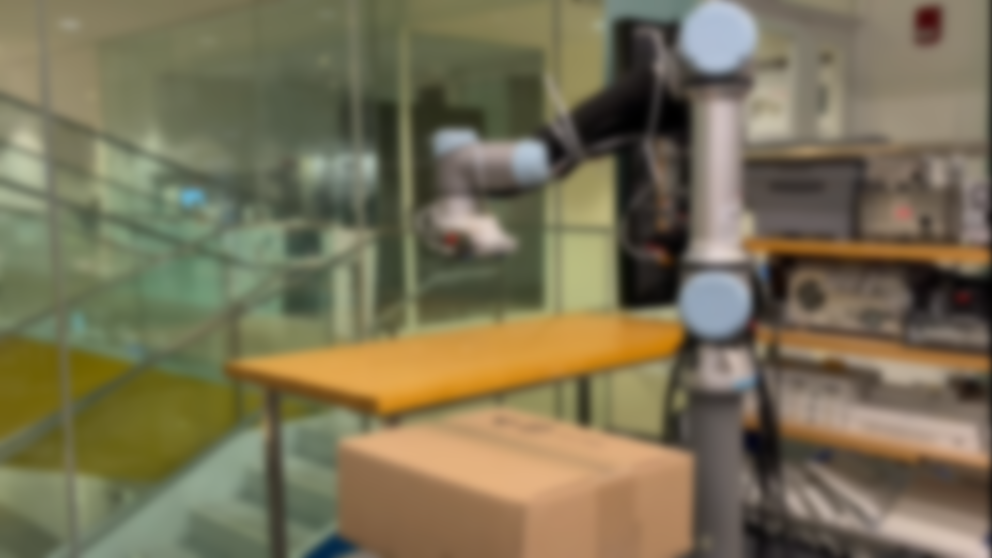

Non-Line-of-Sight 3D Object Reconstruction via mmWave Surface Normal Estimation
Laura Dodds, Tara Boroushaki, Kaichen Zhou, Fadel Adib
Cartesian
Systems

Slide 77
How can we go from 3D imaging to 3D reconstruction?

Slide 78
How can we go from 3D imaging to 3D reconstruction?

Slide 79
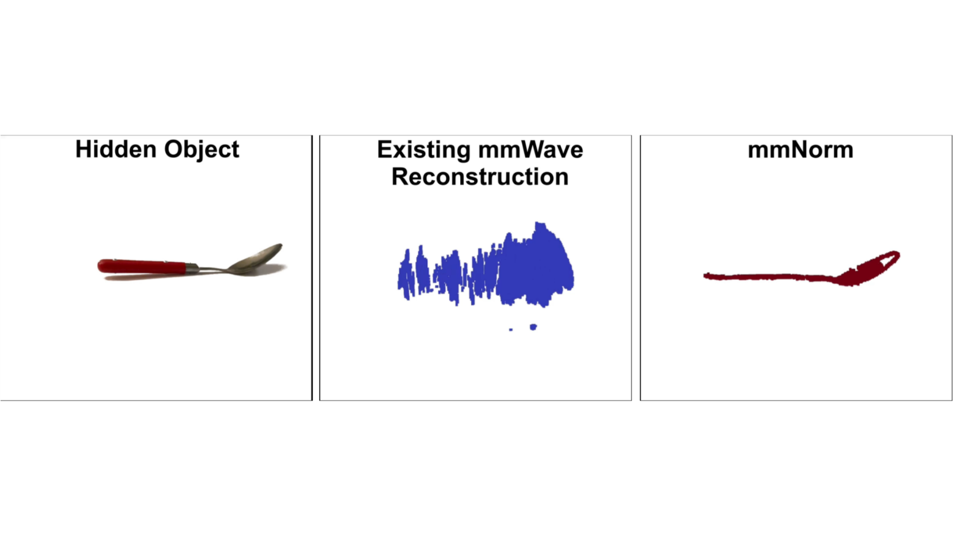
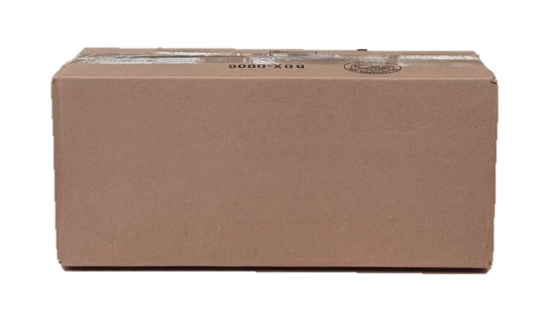
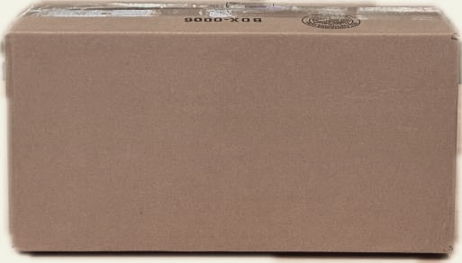
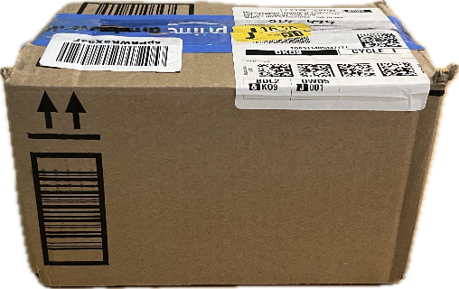
How can we go from 3D imaging to 3D reconstruction?
*
Range
Resolution
Naïve Solution: Select every voxel above a power threshold
* Mobicom ‘24

Slide 80
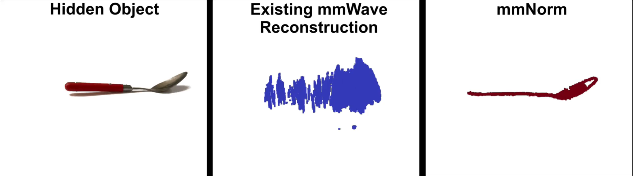
How can we go from 3D imaging to 3D reconstruction?
*
* Mobicom ‘24

Slide 81
High-Accuracy Non-Line-of-Sight 3D Reconstruction has Many Applications
Robotics
Shipping & Logistics
Augmented Reality
camera view static (gone), robot scanning (v fast or only partial),
- camera view gets bigger, open box
- blur to spoon
gets smaller
Add baseline
Add ours
Spin all 3

Slide 82
mmNorm
A new & highly-accurate method for 3D object reconstruction leveraging an entirely first-principles based approach
Introduces techniques for mmWave Surface Normal Estimation and mmWave Structural Isosurface Optimization
Achieves a qualitative leap in mmWave reconstruction over state-of-the-art methods

Slide 83

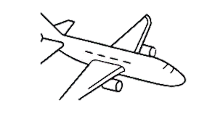









How do existing methods perform 3D reconstruction?
Elevation
Airplane with
Radar
Azimuth
Range
2D Synthetic Aperture
Synthetic Aperture
Produce a 3D SAR Image
Generate 3D point cloud
TomoSAR, 1997
Notes:
Now before I tell you how mmNorm works, it is helpful for me to first explain how existing methods perform 3d reconstruction. Now for the most part, we as a community have been performing 3D reconstruction in the same way for decades. For example, it startwed when we wanted to reconstruct large scale scenese such as this mountain scene. So we as a community mounted a radar onto an airplane or satellite, and have the airplane fly over the scene, continuously collecting measurements to produce a synthetic aperture. Then, we can have the same airplane fly over the scene multiple times to expand our synthetic aperture into a 2D synthetic aperture.
This allows us to measure the range, azimuth, and elevation to different reflectors in the scene. With this, we can produce a 3D SAR image, and use this to generate a 3D point cloud.

Slide 84
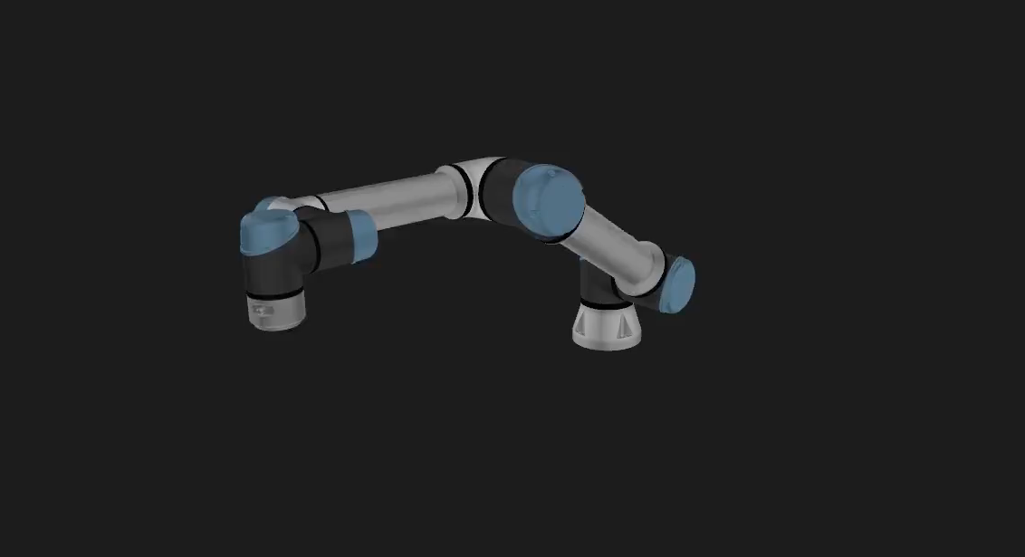
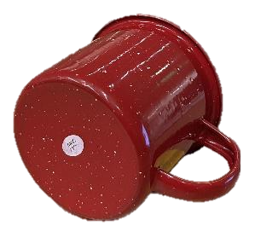
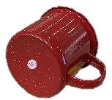

How do existing methods perform 3D reconstruction?
Produce a 3D SAR Image
Object to
Reconstruct
Generate 3D point cloud
Reconstruction quality is limited by SAR resolution (i.e., bandwidth)
IMWUT ‘23, Mobicom ‘24
Notes:
Now when we as a community wanted to move from these large scale scenes to much smaller objects, we applied almost the exact same approach. For example, to reconstruct this mug here, past work has attached a radar to a robot or linear stage. The robot then moves the radar, again collecting a 2D synthetic aperture. Again, we can produce a 3D SAR image, and use this to generate a 3D point cloud.
But this time, there is a problem. Unlike before, where we were reconstructing massive mountain scenes, we are now trying to reconstruct a tiny mug. This means that now our reconstruction quality is severely limited by our SAR resolution, which in this case is limited by our commercially available bandwidth.

Slide 85

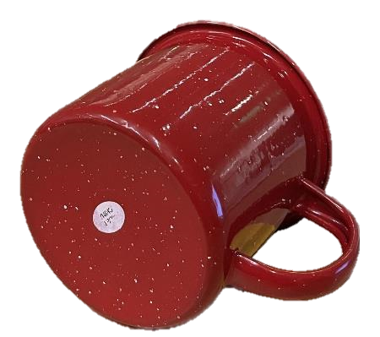
How do existing methods perform 3D reconstruction?
Real-World
3D Point Cloud
Reconstruction quality is limited by SAR resolution (i.e., bandwidth)

Slide 86
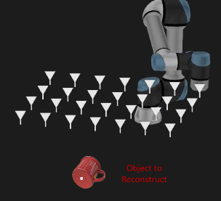

How do existing methods perform 3D reconstruction?
First-Principles Methods
Machine-Learning Methods
Points are spread due to limited resolution
3D Model
We need a fundamentally new approach for
mmWave 3D object reconstruction
Requires Significant Training Data
Our Idea: Directly estimate the curvature of the object
Reconstruction quality is limited by SAR resolution (i.e., bandwidth)
Typically operate on very small subset of objects
CVPR ‘20, Mobicom ‘24

Slide 87
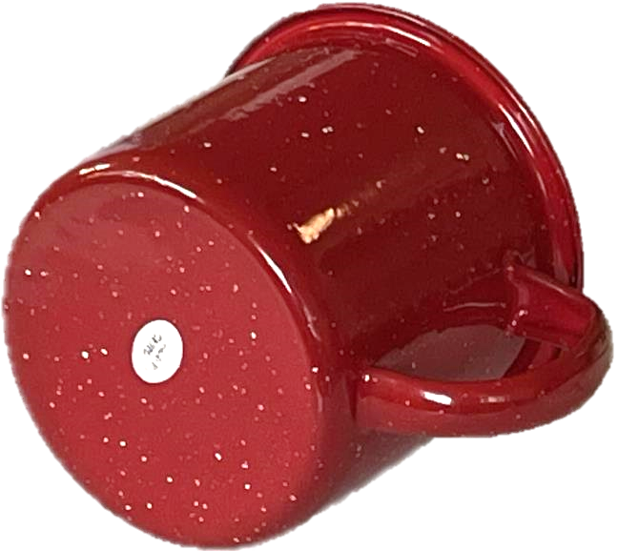
Our Idea: Directly estimate the curvature of the object
by estimating surface normal vectors
Surface
Normal
Vector

Slide 88
Our Idea: Directly estimate the curvature of the object
by estimating surface normal vectors

Slide 89
Our Idea: Directly estimate the curvature of the object
by estimating surface normal vectors
Surface Normal Vector Field
Synthetic
Aperture

Slide 90
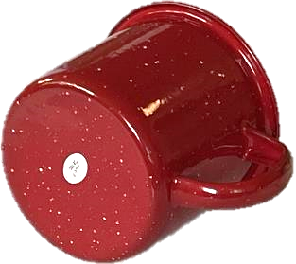
Our Idea: Directly estimate the curvature of the object
by estimating surface normal vectors
1. Normal Field Estimation

Slide 91
Our Idea: Directly estimate the curvature of the object
by estimating surface normal vectors
1. Normal Field Estimation
2. Multiple Valid Surfaces

Slide 92
Our Idea: Directly estimate the curvature of the object
by estimating surface normal vectors
1. Normal Field Estimation
2. Multiple Valid Surfaces
3. Single Unifying
Function
4. Isosurface
Optimization
Relative Signed Distance Function
Isosurface: Surface of constant value

Slide 93
Our Idea: Directly estimate the curvature of the object
by estimating surface normal vectors
1. Normal Field Estimation
2. Multiple Valid Surfaces
3. Single Unifying
Function
4. Isosurface
Optimization
Relative Signed Distance Function
Isosurface: Surface of constant value
Final Surface Estimate

Slide 94
Our Idea: Directly estimate the curvature of the object
by estimating surface normal vectors
Synthetic
Aperture

Slide 95
Our Idea: Directly estimate the curvature of the object
by estimating surface normal vectors
Synthetic
Aperture

Slide 96
Our Idea: Directly estimate the curvature of the object
by estimating surface normal vectors
Synthetic
Aperture
Object Surface

Slide 97
mmWave signals experience primarily specular reflections
Synthetic
Aperture
Signal Received
No Signal Received
Object Surface

Slide 98
At a given voxel, what direction is the surface normal?
Lets say one of these antennas receive a reflection from this voxel
Possible Surface Normals
Due to specularity, these normal do not produce reflections towards the aperture
Voxel

Slide 99
At a given voxel, what direction is the surface normal?
v₁
v₂
v₃
v₄
v₅
v₆
v₇
Voxel
Reflection amplitude acts as a vote

Slide 100
At a given voxel, what direction is the surface normal?
v₁
v₂
v₃
v₄
v₅
v₆
v₇
Reflection amplitude acts as a vote

Slide 101
At a given voxel, what direction is the surface normal?
Example 2
Example 1
v₁
v₂
v₃
v₄
v₅
v₆
v₇
Reflection amplitude acts as a vote

Slide 102
At a given voxel, what direction is the surface normal?
Example 2
Example 1
v₁
v₂
v₃
v₄
v₅
v₆
v₇
Reflection amplitude acts as a vote

Slide 103
At a given voxel, what direction is the surface normal?
Example 2
Example 1
v₁
v₂
v₃
v₄
v₅
v₆
v₇
v₁
v₂
v₃
v₄
v₅
v₆
v₇
Reflection amplitude acts as a vote

Slide 104
At a given voxel, what direction is the surface normal?
Example 2
Example 1
v₁
v₂
v₃
v₄
v₅
v₆
v₇
v₁
v₂
v₃
v₄
v₅
v₆
v₇
Reflection amplitude acts as a vote

Slide 105

At a given voxel, what direction is the surface normal?
v₁
v₂
v₃
v₄
v₅
v₆
v₇
Weighted Sum
$$\overset{⃑}{n}\left(u\right)=\sum_{k=0}^{N}{v_{k} \frac{p_{k}−u}{|\left|p_{k}−u\right||}}$$
arriving from this voxel in SAR image
Reflection amplitude acts as a vote

Slide 106








How do we compute the voting function?
Reflection amplitude acts as a vote
arriving from this voxel in SAR image
Individual
Antenna
Value
$$\sum_{i=1}^{M}{}$$
$$e^{{j2πd(v,k)}/{λ_{i}}}$$
$$I(k)=$$
$$h\left(i,k\right)$$
Sum across
frequency
Received
signal
Expected
signal
$$\sum_{k=1}^{N}{}$$
$$S$$
$$=$$
$$I(k)$$
mmWave
Voxel Value
Sum across
antennas
Individual
Antenna
Values

Slide 107









How do we compute the voting function?
Reflection amplitude acts as a vote
arriving from this voxel in SAR image
Q
Small Projection Magnitude
Antenna 1 Value
I
We repeat this at every voxel in space to produce a normal vector field
$$\sum_{i=1}^{M}{}$$
$$\sum_{k=1}^{N}{}$$
$$e^{{j2πd(v,k)}/{λ_{i}}}$$
$$I(k)$$
Large Projection Magnitude
$$I(k)=$$
$$h\left(i,k\right)$$
$$S$$
$$=$$
Antenna 2 Value
mmWave
Voxel
Value
Voting Function: $v_{k}=\frac{ℜ\left\{I\left(k\right)\right\}ℜ\left\{S\right\}+ℑ\left\{I\left(k\right)\right\}ℑ\{S\}}{|\left|S\right||}$

Slide 108
Our Idea: Directly estimate the curvature of the object
by estimating surface normal vectors
1. Normal Field Estimation
2. Multiple Valid Surfaces
3. Single Unifying
Function
4. Isosurface
Optimization
Relative Signed Distance Function
Isosurface: Surface of constant value
Final Surface Estimate

Slide 109


How can we capture all ambiguous surfaces in one function?
Computer Graphics
mmNorm
Signed Distance Function
Normal Vector
Field
Positive values
0 at surface of object
Negative values
$$\frac{d}{dx}$$
$$\int{dx}$$
Normal Vector
Field
Relative Signed Distance Function
Unknown constant offset

Slide 110
How can we capture all ambiguous surfaces in one function?
Computer Graphics
mmNorm
Signed Distance Function
Normal Vector
Field
Positive values
0 at surface of object
Negative values
$$\frac{d}{dx}$$
$$\int{dx}$$
Normal Vector
Field
Relative Signed Distance Function
Unknown constant offset

Slide 111
How can we capture all ambiguous surfaces in one function?
Computer Graphics
mmNorm
Signed Distance Function
Normal Vector
Field
Positive values
0 at surface of object
Negative values
$$\frac{d}{dx}$$
$$\int{dx}$$
Normal Vector
Field
Relative Signed Distance Function
Unknown constant offset

Slide 112
How can we capture all ambiguous surfaces in one function?
Computer Graphics
mmNorm
Signed Distance Function
Normal Vector
Field
Positive values
0 at surface of object
Negative values
$$\frac{d}{dx}$$
$$\int{dx}$$
Normal Vector
Field
Relative Signed Distance Function
Unknown constant offset

Slide 113
How can we capture all ambiguous surfaces in one function?
Computer Graphics
mmNorm
Signed Distance Function
Normal Vector
Field
Positive values
0 at surface of object
Negative values
$$\frac{d}{dx}$$
$$\int{dx}$$
Normal Vector
Field
We can determine the surface by finding this unknown constant offset
Relative Signed Distance Function
Unknown constant offset

Slide 114

Our Idea: Directly estimate the curvature of the object
by estimating surface normal vectors
1. Normal Field Estimation
2. Multiple Valid Surfaces
3. Single Unifying
Function
4. Isosurface
Optimization
Relative Signed Distance Function
$$L\left(C\right)=\sum_{k=1}^{N}{\left\|\begin{aligned}\left|FFT\left(\hat{h\left(i,k\right) }\right)\right|− \\ \left|FFT(h\left(i,k\right))\right|\end{aligned}\right\|}$$
Isosurface: Surface of constant value
Final Surface Estimate

Slide 115
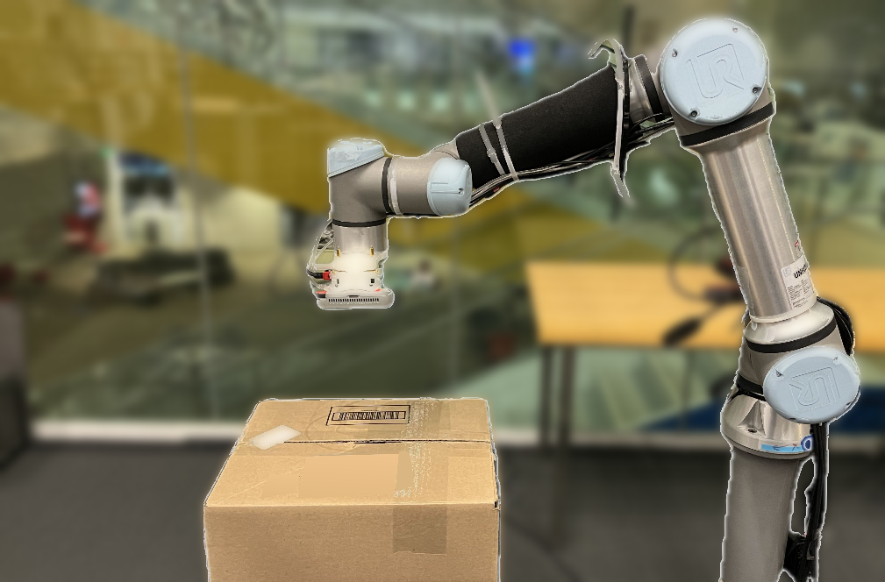
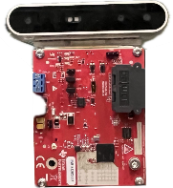
Implementation
UR5e Robot Arm
TI IWR1443Boost 77GHz Radar
Intel Realsense RGB-D camera for ground truth
Measured experiments in line-of-sight and non-line-of-sight (cardboard occlusion)
Collected experiments across 61 different everyday objects
Camera (Ground-Truth)
Robot Arm
77GHz Radar
Cardboard
Occlusion

Slide 116
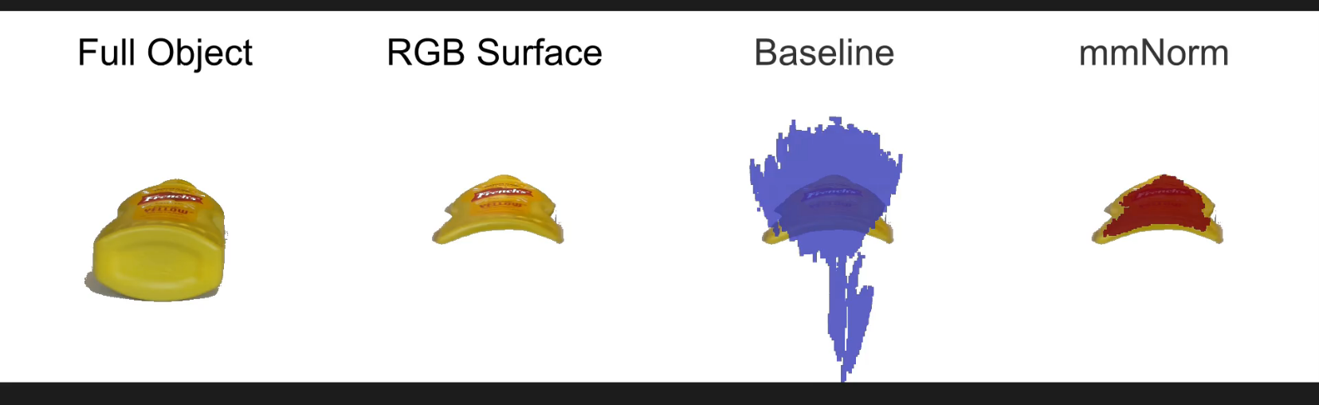
Qualitative Results
Select every voxel in SAR image above power threshold

Slide 117

Qualitative Results

Slide 118
Qualitative Results
Measured 61 diverse everyday objects (YCB dataset)
Measure the distance from each point in the reconstruction to its nearest point in the ground truth
1.4 cm
0.25 cm

Slide 119









mmNorm: A paradigm shift in mmWave reconstruction
Shape Completion
Novel Downstream Tasks
Large Scale Scenes
Robotics
Indoor
Scenes
Augmented Reality
Autonomous Driving

Slide 120
mmNorm: A paradigm shift in mmWave reconstruction
Shape Completion
Novel Downstream Tasks
Large Scale Scenes
Robotics
Indoor
Scenes
Augmented Reality
Autonomous Driving

Slide 121

mmNorm: A paradigm shift in mmWave reconstruction
Shape Completion
Novel Downstream Tasks
Large Scale Scenes
Robotics
Indoor
Scenes
Augmented Reality
Autonomous Driving

Slide 122

mmNorm: A paradigm shift in mmWave reconstruction
Novel Downstream Tasks
Large Scale Scenes
mmNorm Code
Robotics
Indoor
Scenes
Augmented Reality
Autonomous Driving

Slide 123








Limitation of mmNorm: Coverage
Wave-Former:
Physics-Aware Shape Completion
Applying Vision-Based Shape-Completion
Ground-Truth
mmNorm
Poor Reconstruction
Missing
Surface

Slide 124
Wave-Former: Physics-Aware Shape Completion
Physics Aware
Transformer Encoder
Physics Aware
Transformer Encoder
Joint Refinement
& Completion
Feature Extractor
Incorporate :
mmWave Noise
Antenna FoVs
Allows for training entirely on synthetic data and
testing on real world data
Specularity-Aware Inductive Bias:
Predict visible portions based on mmWave Physics

Slide 125
Extending Computer Vision to Hidden Objects
A Tutorial on Millimeter-Wave Imaging and Reconstruction of Occluded Scenes
mmWave 101: Basics of mmWave Imaging, Limitations
State-of-the-art Reconstruction Methods
mmWave Neural Radiance Fields
Coffee Break
Vision-quality mmWave Scene Understanding
Open Problems; Tour of Existing Datasets & Tools
Hands-On Tutorial: mmWave Imaging & Reconstruction

Slide 126
Extending Computer Vision to Hidden Objects
A Tutorial on Millimeter-Wave Imaging and Reconstruction of Occluded Scenes
mmWave 101: Basics of mmWave Imaging, Limitations
State-of-the-art Reconstruction Methods
mmWave Neural Radiance Fields
Coffee Break
Vision-quality mmWave Scene Understanding
Open Problems; Tour of Existing Datasets & Tools
Hands-On Tutorial: mmWave Imaging & Reconstruction

Slide 127
Extending Computer Vision to Hidden Objects
A Tutorial on Millimeter-Wave Imaging and Reconstruction of Occluded Scenes
mmWave 101: Basics of mmWave Imaging, Limitations
State-of-the-art Reconstruction Methods
mmWave Neural Radiance Fields
Coffee Break
Vision-quality mmWave Scene Understanding
Open Problems; Tour of Existing Datasets & Tools
Hands-On Tutorial: mmWave Imaging & Reconstruction

Slide 128
Extending Computer Vision to Hidden Objects
A Tutorial on Millimeter-Wave Imaging and Reconstruction of Occluded Scenes
mmWave 101: Basics of mmWave Imaging, Limitations
State-of-the-art Reconstruction Methods
mmWave Neural Radiance Fields
Coffee Break
Vision-quality mmWave Scene Understanding
Open Problems; Tour of Existing Datasets & Tools
Hands-On Tutorial: mmWave Imaging & Reconstruction

Slide 129
Existing Tools
Objects
Humans
Self-Driving
Scenes
MITO – 500 images SquiggleMilli – Handheld imaging – 1500 samples | mmBody – 200k frames Milipoint – 500k frames Mmvr – 300k frames | Radatron – 500k frames Seeing through fog without seeing fog – 100k labeled pts nuScenes - 1k scenes K-Radar - | PanoRadar – 12 buildings CartoRadar – 6k Frames GRT – 1M
MITO – Ray casting based simulator GeRaF – mmWave NeRF |  |  | NVIDIA Sionna RT – Designed for mmWave Communication
Real-World
Datasets
Open-Source Simulations
Notes:
Achieving camera-quality:
Segmentation
Classification
6 DoF Pose Estimation
Smaller Apertures
Real-time Performance
Diffusion Models as Reconstruction Priors for Sparse Apertures
Uncertainty Aware Reconstructions
Multi-modal Fusion: RGB priors for improved reconstruction
Generalizing physical properties between different scales of mmWave imaging
Reducing Sim2Real Gap
mmWave Self-Supervised Learning Techniques

Slide 130
Open Problems
Can we enable generalizable camera-quality mmWave perception?
Reconstruction Under Practical Constraints
mmWave
Foundation Models
Perception Tasks
Generalizing physical insights between different scales of mmWave imaging & other domain shifts
Reducing Sim2Real Gap
mmWave Self-Supervised Learning Techniques
Multi-modal Fusion
Datasets & Benchmarking:
  Make way towards large-scale, cross device, diverse, real-world datasets
Achieving camera-quality:
  Segmentation
  Classification
  6 DoF Pose Estimation
  Material Segmentation / Estimation
Uncertainty Aware Reconstruction
Zero-shot perception
Smaller Apertures
  Train Diffusion Models on reducing aperture sizes
Sparse Apertures
  Diffusion Models as Reconstruction Priors
Real-time Performance
Low Signal-to-Noise Ratio (SNR) environments
  Thicker occlusions, fewer measurements, etc
Notes:
Achieving camera-quality:
Segmentation
Classification
6 DoF Pose Estimation
Smaller Apertures
Real-time Performance
Diffusion Models as Reconstruction Priors for Sparse Apertures
Uncertainty Aware Reconstructions
Multi-modal Fusion: RGB priors for improved reconstruction
Generalizing physical properties between different scales of mmWave imaging
Reducing Sim2Real Gap
mmWave Self-Supervised Learning Techniques

Slide 131
Extending Computer Vision to Hidden Objects
A Tutorial on Millimeter-Wave Imaging and Reconstruction of Occluded Scenes
mmWave 101: Basics of mmWave Imaging, Limitations
State-of-the-art Reconstruction Methods
mmWave Neural Radiance Fields
Coffee Break
Vision-quality mmWave Scene Understanding
Open Problems; Tour of Existing Datasets & Tools
Hands-On Tutorial: mmWave Imaging & Reconstruction

Slide 132
Extending Computer Vision to Hidden Objects
A Tutorial on Millimeter-Wave Imaging and Reconstruction of Occluded Scenes
mmWave 101: Basics of mmWave Imaging, Limitations
State-of-the-art Reconstruction Methods
mmWave Neural Radiance Fields
Coffee Break
Vision-quality mmWave Scene Understanding
Open Problems; Tour of Existing Datasets & Tools
Hands-On Tutorial: mmWave Imaging & Reconstruction

Slide 133


We would appreciate your feedback!
Hands-On Tutorial
https://tinyurl.com/cvpr-mmwave
https://tinyurl.com/mmwave-tutorial

